Slide 1
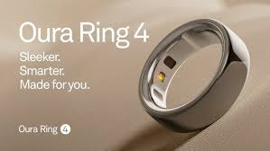

oura ring
NEEV AND Aadhvik

Slide 2
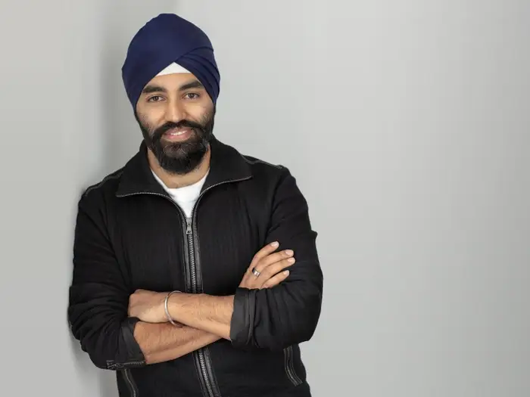
why was oura ring founded
to empower individuals to better understand their health and well-being through advanced technology and personalized insights.

Slide 3
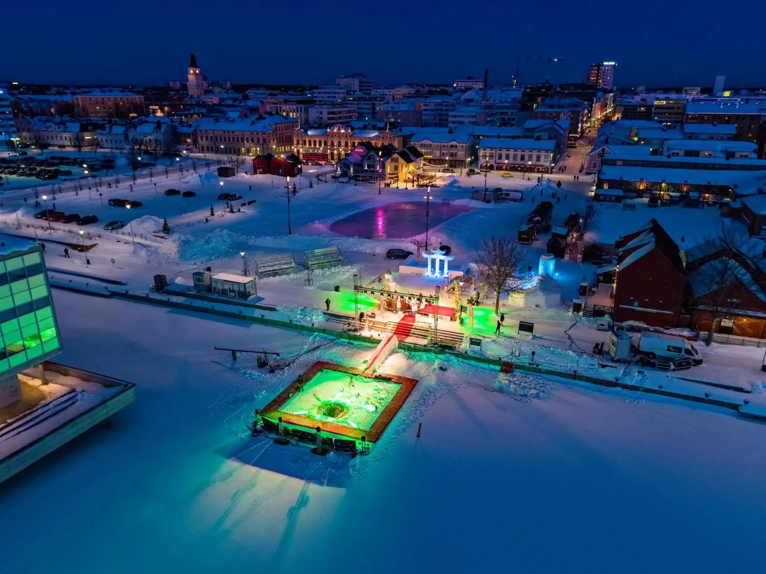
Where was Oura Ring was founded in
Oulu, Finland

Slide 4
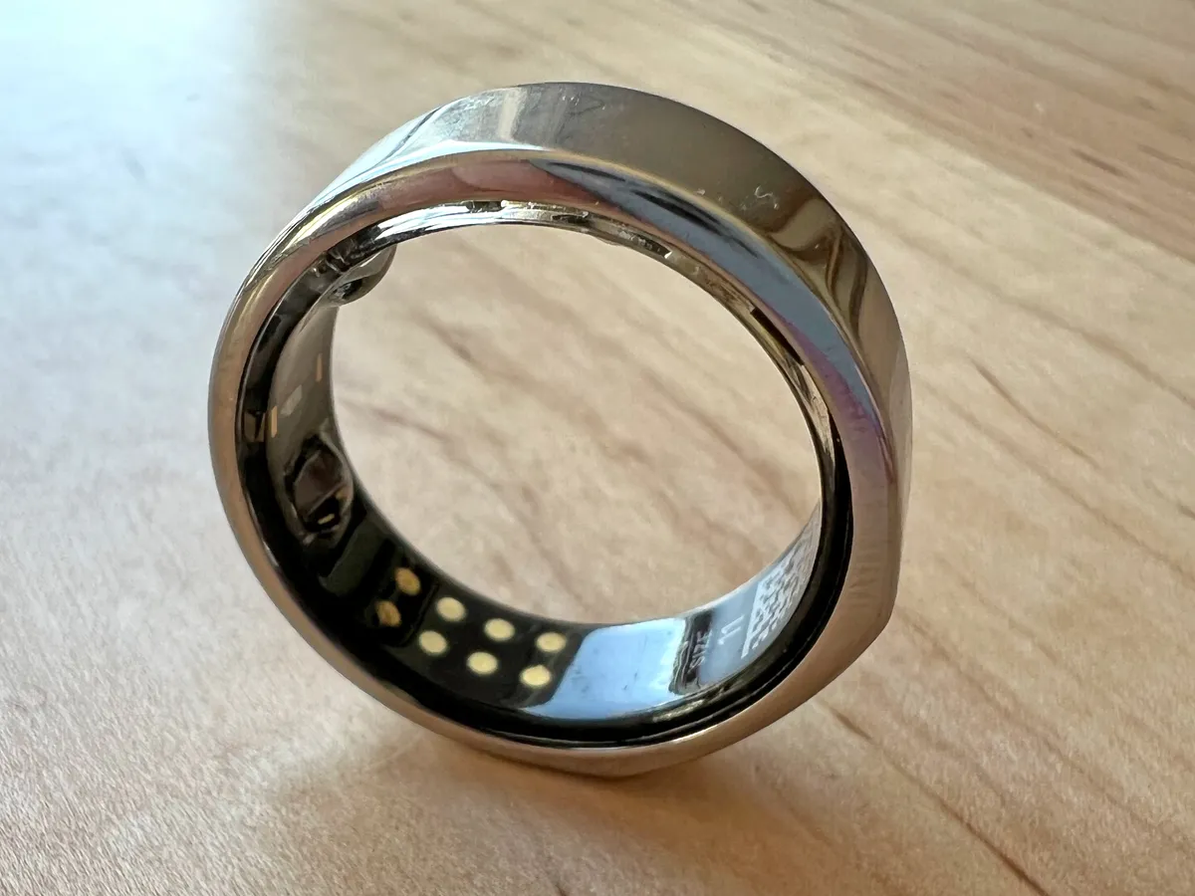
When was it found
it founded 2013

Slide 5
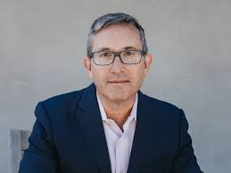
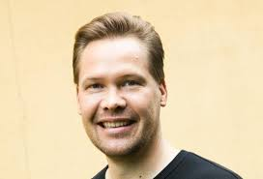
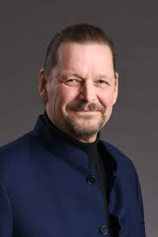
Oura Ring was founded
Petteri Lahtela, Kari Kivelä, and Markku Koskela

Slide 6
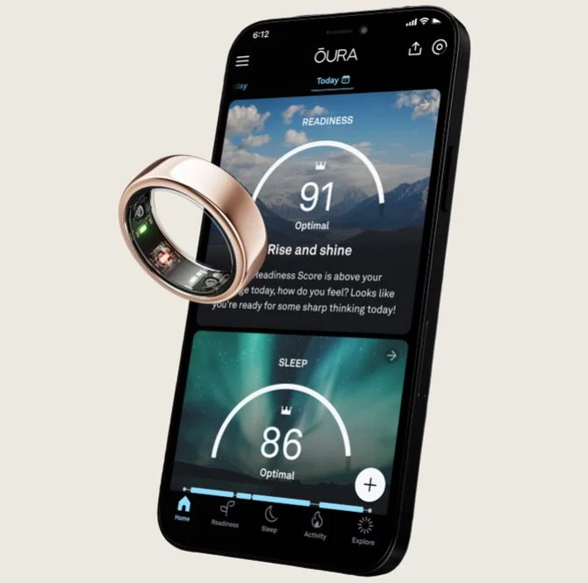
what innovation propose is oura ring
proposes continued innovation in the following areas of wearable health technology

Slide 7
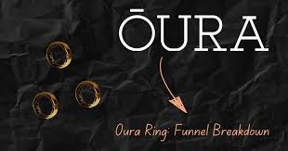
did oura ring gain immediate success
It didn success immediate

Slide 8
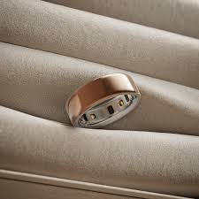
popularity
oura ring didn't today fail and it is popular

Slide 9
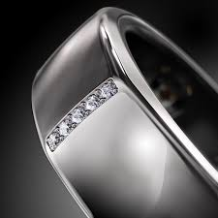
Achieve goal
Yes, the Oura Ring has largely achieved its core goals

